Slide 1

FINANCIAL FLUX
Buy, Sell and Trade Stock portfolio management website
Presented By:
CB.SC.U4AIE23037 - KEERTHIVASAN S.V.
CB.SC.U4AIE23044 - BAVESH REDDY M.S.

Slide 2


OBJECTIVE OF OUR PROJECT:
Login Page Using Firebase:
We integrated Firebase into our project for authentication. This involved setting up a Firebase project, enabling authentication services, and adding the Firebase SDK to our website. We implemented user login & registration using Firebase Authentication, utilizing Firebase's built-in methods for handling these operations securely. We ensured that the login and registration forms had proper validation for email format, password strength, and other necessary fields. We managed user sessions with Firebase Authentication, ensuring users stayed logged in across different pages and sessions were properly invalidated upon logout.
Using XAMPP for Hosting:
We installed and configured XAMPP on our local machines to provide a local server environment with Apache.
Showing Stock Data Using an External Excel Sheet:
We read stock data from an external Excel sheet using JavaScript libraries like SheetJS. We parsed the Excel data and displayed it on our website in a user-friendly format, such as a table or chart.
Creating Different Pages:
We implemented the login functionality as described above. We created a dashboard page that displayed relevant information such as user profile and stock data. We designed an 'About Us' page that provided information about the website. We developed a pricing page that outlined different stocks, using clear and concise pricing tables.

Slide 3
The Flow of Financial flux:
LOGIN
CREATE ACCOUNT
HOME PAGE
DASHBOARD
STOCKS
ABOUT US

Slide 4
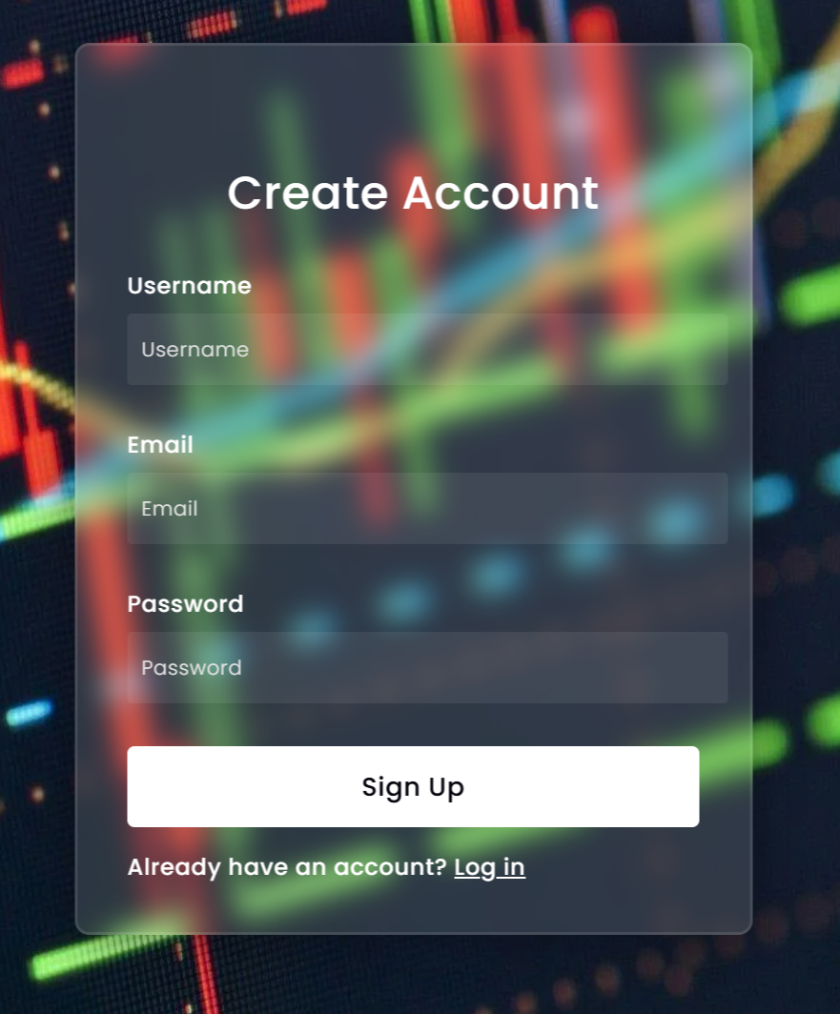
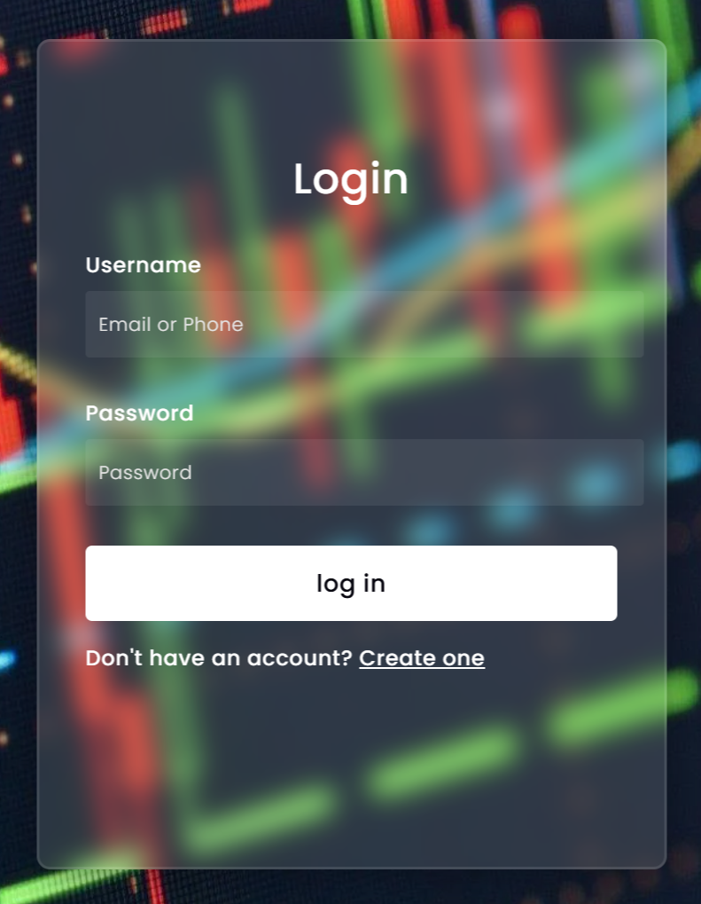

CREATE ACCOUNT PAGE (register):
LOGIN PAGE (login):

Slide 5
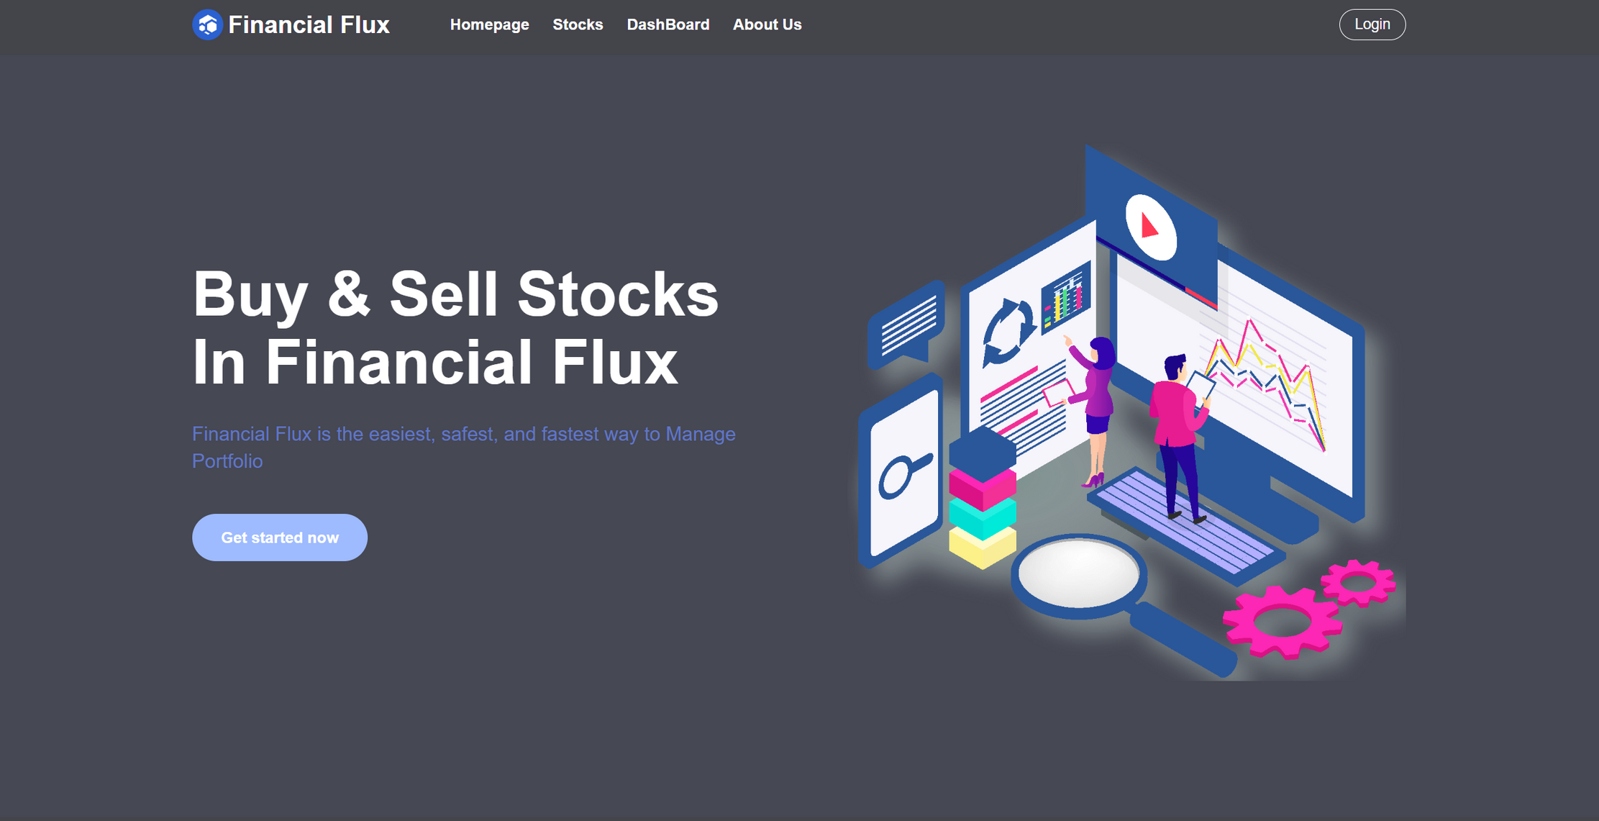
HOME PAGE (index):

Slide 6
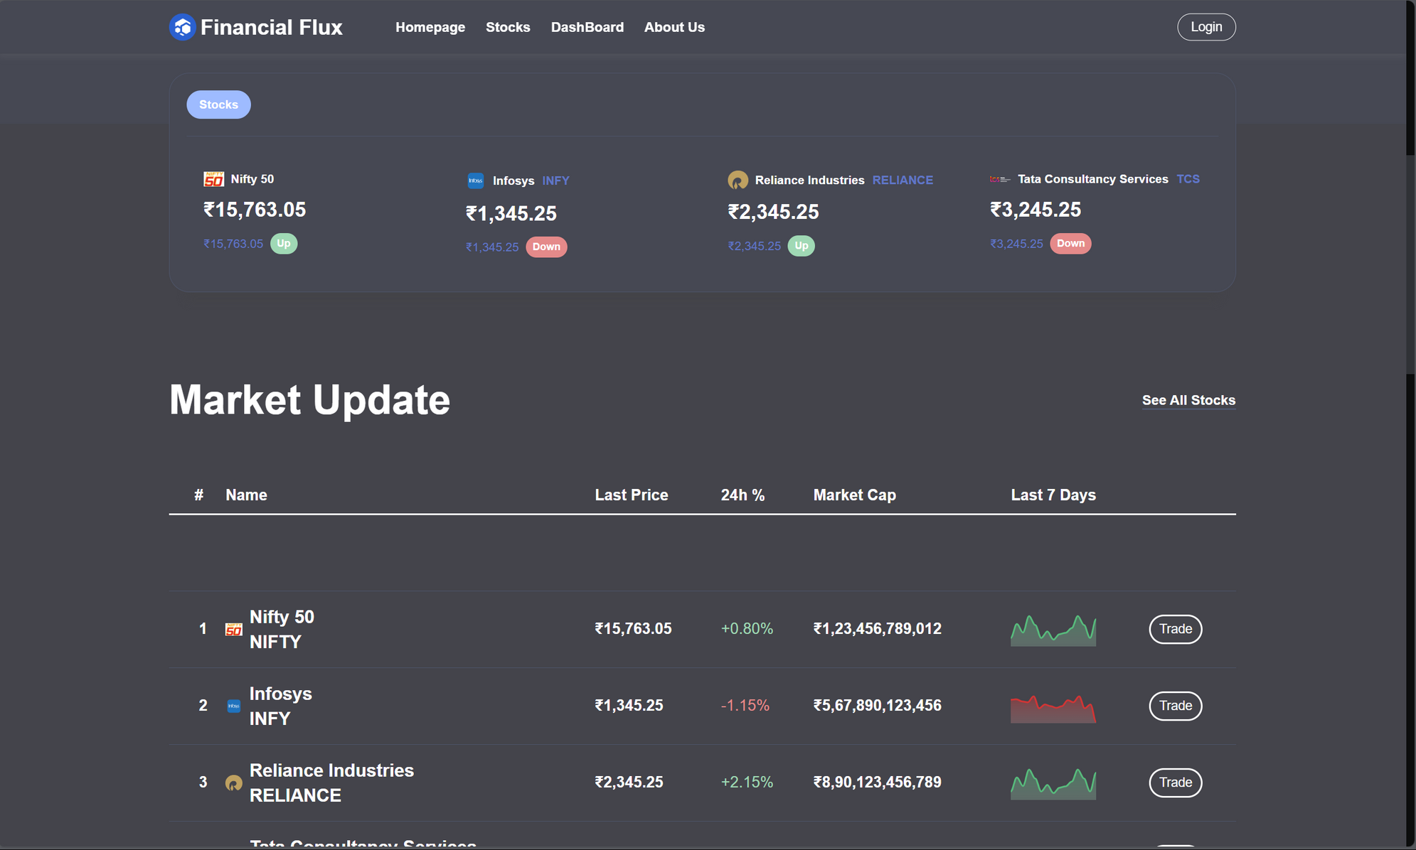
HOME PAGE (index):

Slide 7
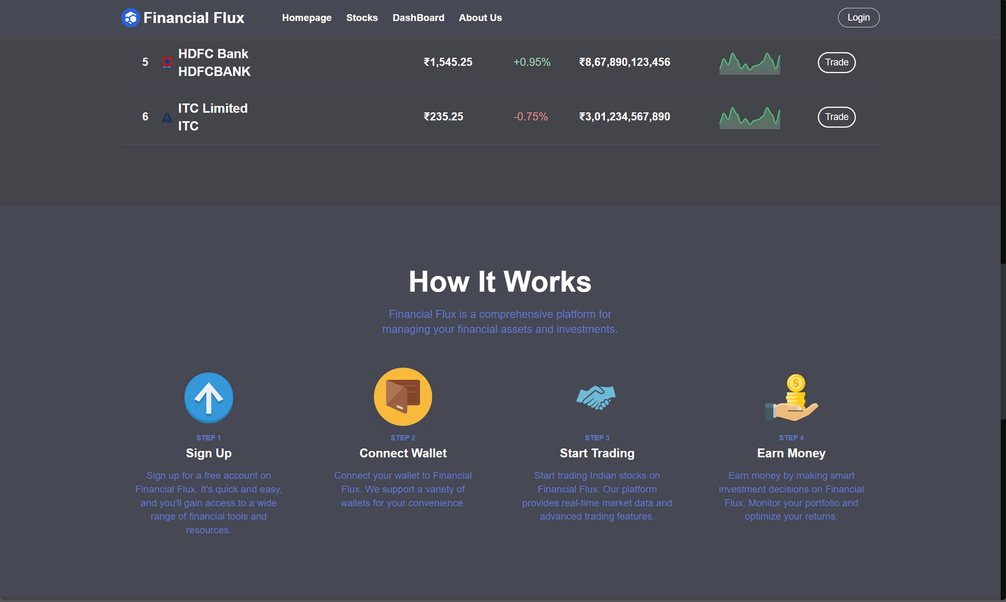
HOME PAGE (index):

Slide 8
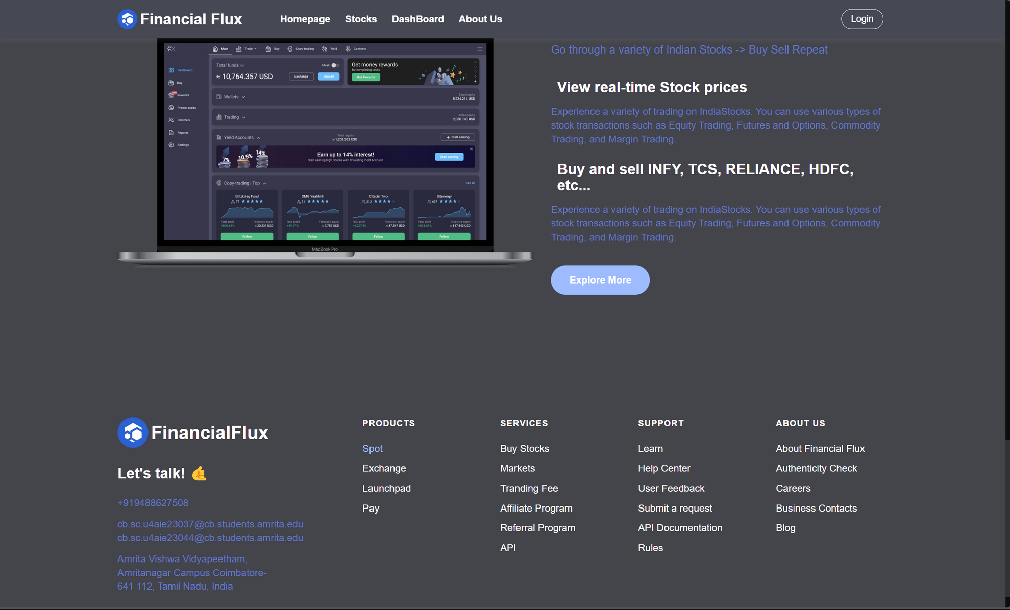
HOME PAGE (index):

Slide 9
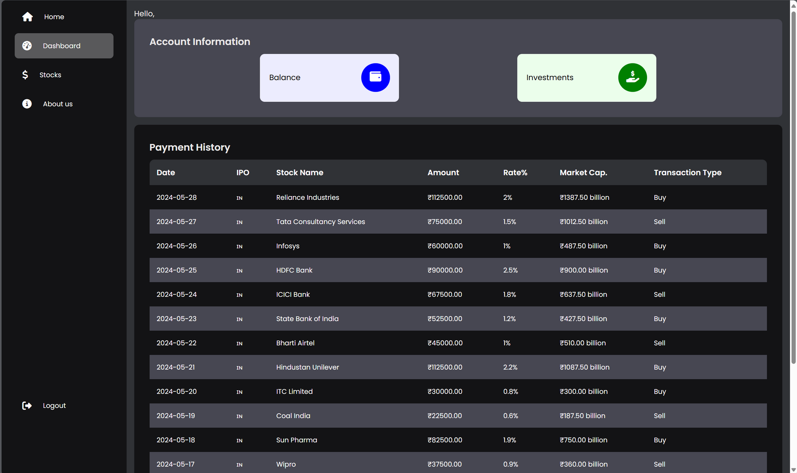
Dashboard (dashboard):

Slide 10
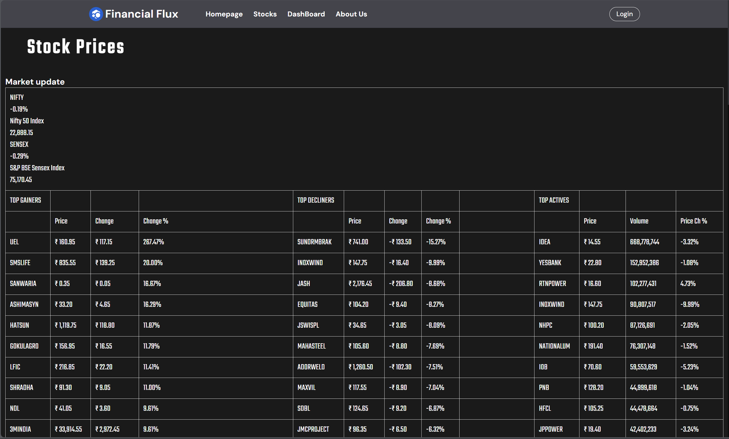
Stocks (pricing):

Slide 11
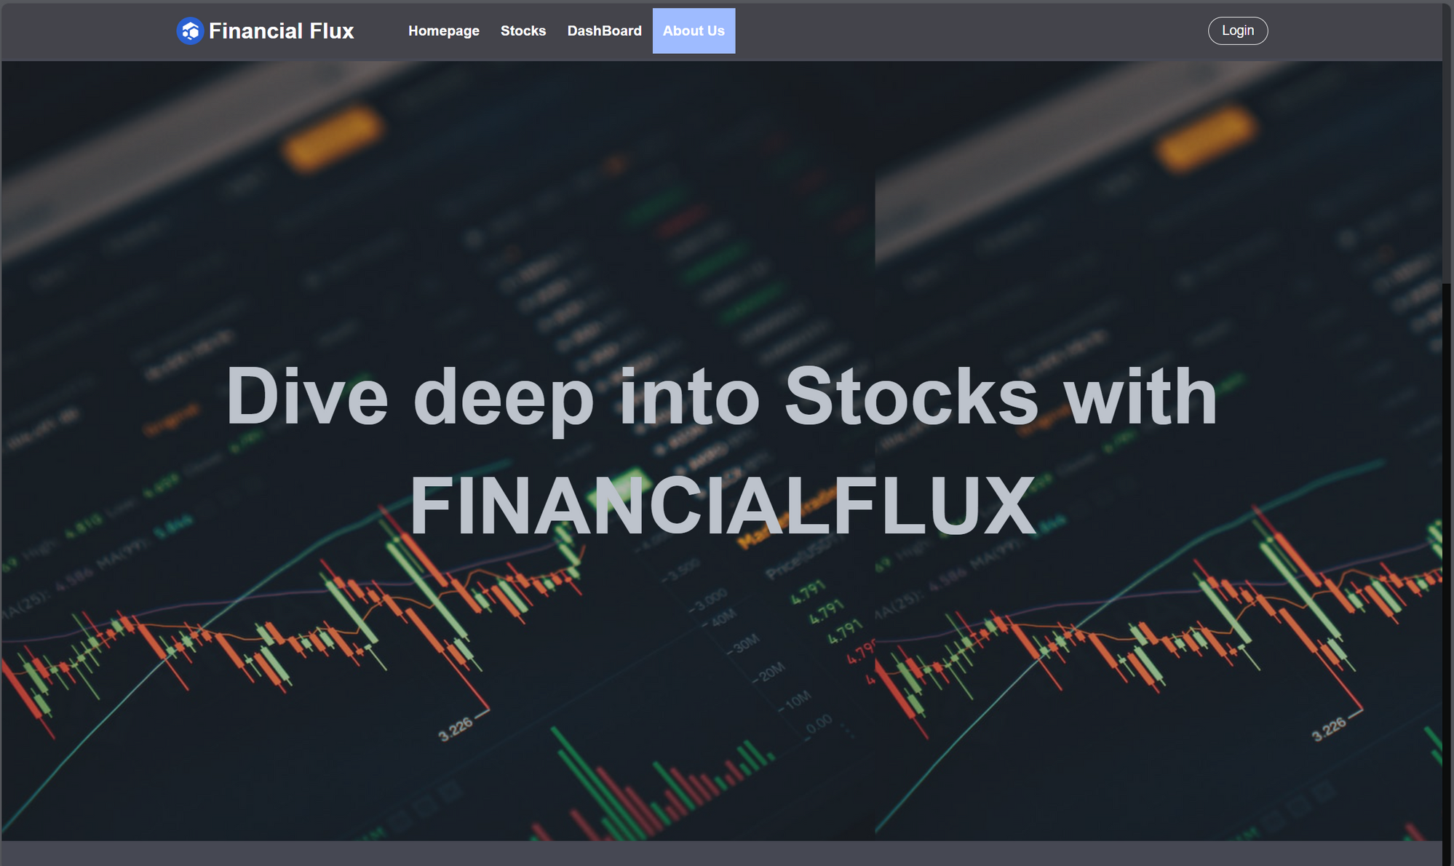
About Us (about.html):

Slide 12
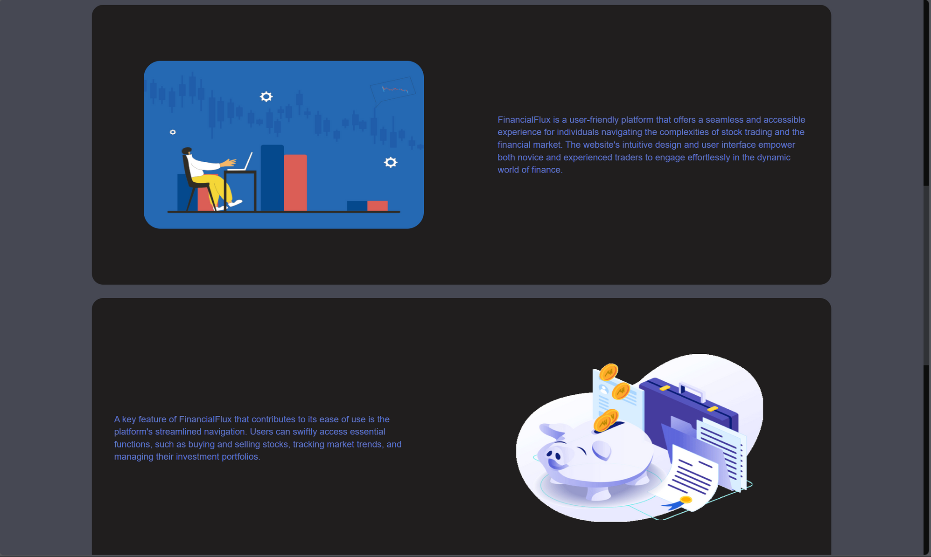
About Us (about.html):

Slide 13
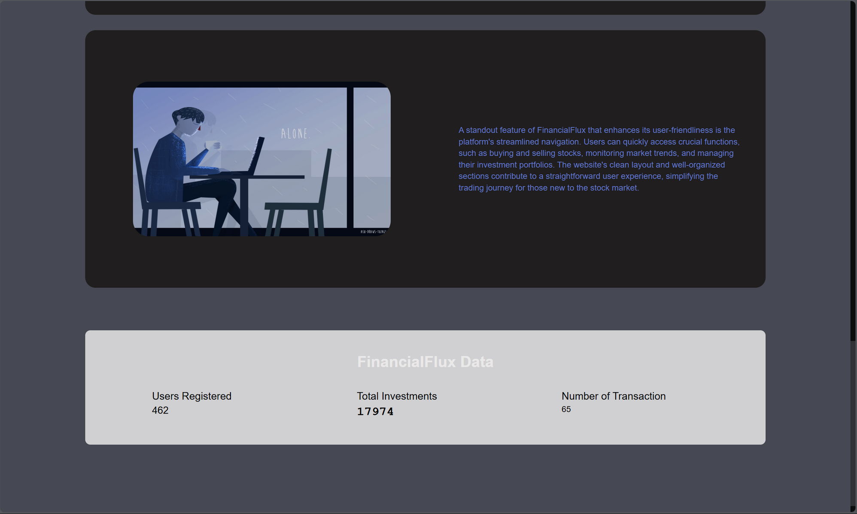
About Us (about.html):

Slide 14
Conclusion:
All the steps outlined above have been successfully implemented, resulting in a robust, responsive, and user-friendly website with secure user authentication managed by Firebase. The website now effectively displays stock data through integration with an external Excel sheet. Using XAMPP for local hosting has provided a stable development environment, ensuring smooth deployment to a live server. The various pages, including the login page, dashboard, About Us, pricing page, and additional necessary pages, are well-structured and easily navigable, providing users with a comprehensive and engaging experience.

